Slide 1
Introduction to Machine Learning

Slide 2
Before Starting the Course
Upon completion of this course, you will have acquired general knowledge of introductory artificial intelligence algorithms and data analysis.
The person receiving the course needs to practice a lot in order to learn the subject better after the lesson.

Slide 3
What You Will Learn In This Course
What is Machine Learning?
What innovations has Machine Learning brought to our lives?
What are the requirements and additional capabilities for Machine Learning?
What is Data Science?
What is data cleaning, provisioning and attribute engineering?
What are the steps of a Machine Learning project?
What are the tools used in Machine Learning?
What are useful resources for Machine Learning?
Hands-on Training: What does a machine learning project look like?

Slide 4
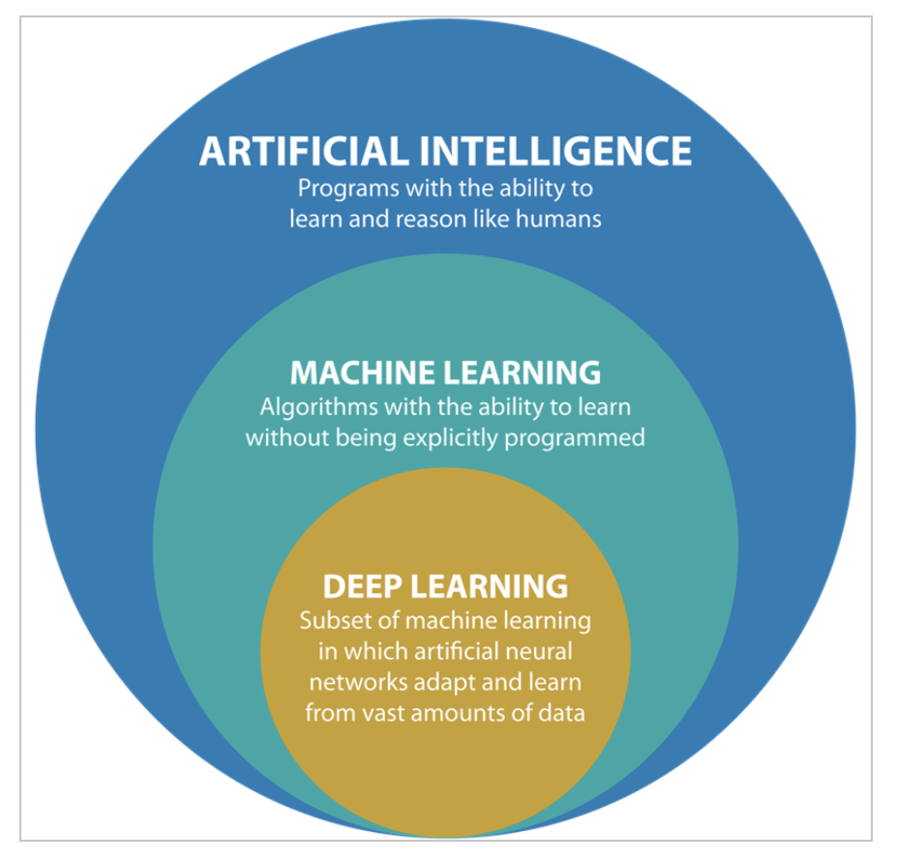
Machine Learning Disambiguation

Slide 5
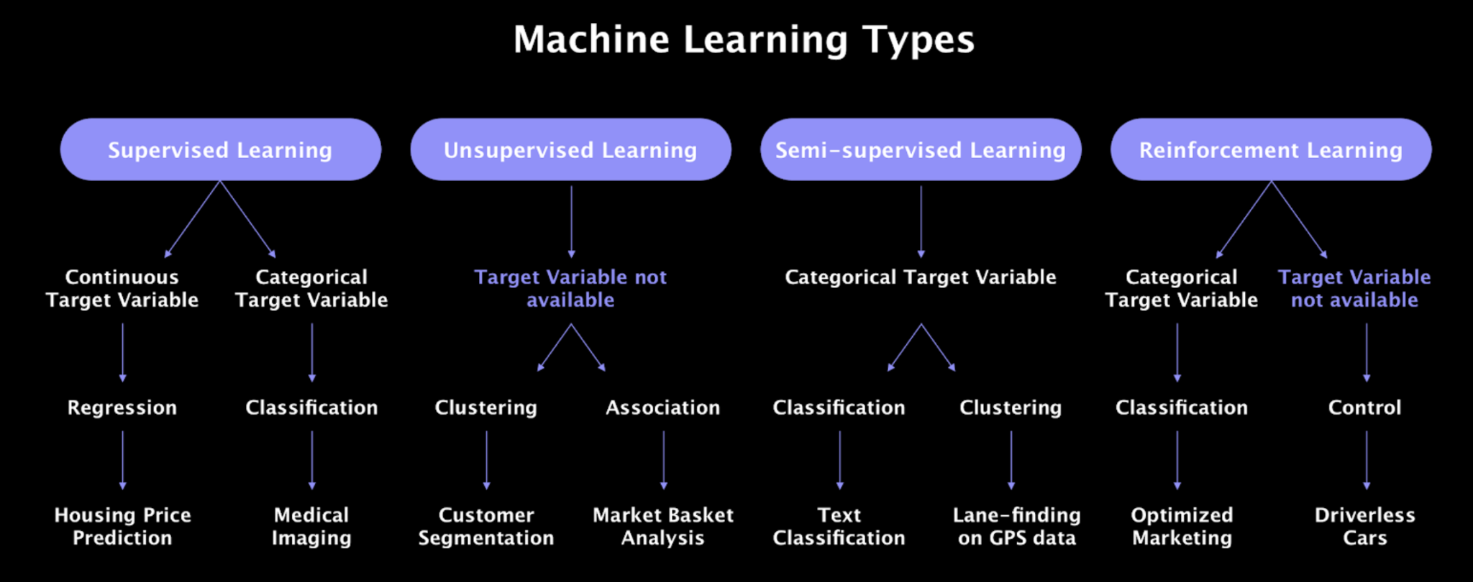
Types of Machine Learning

Slide 6
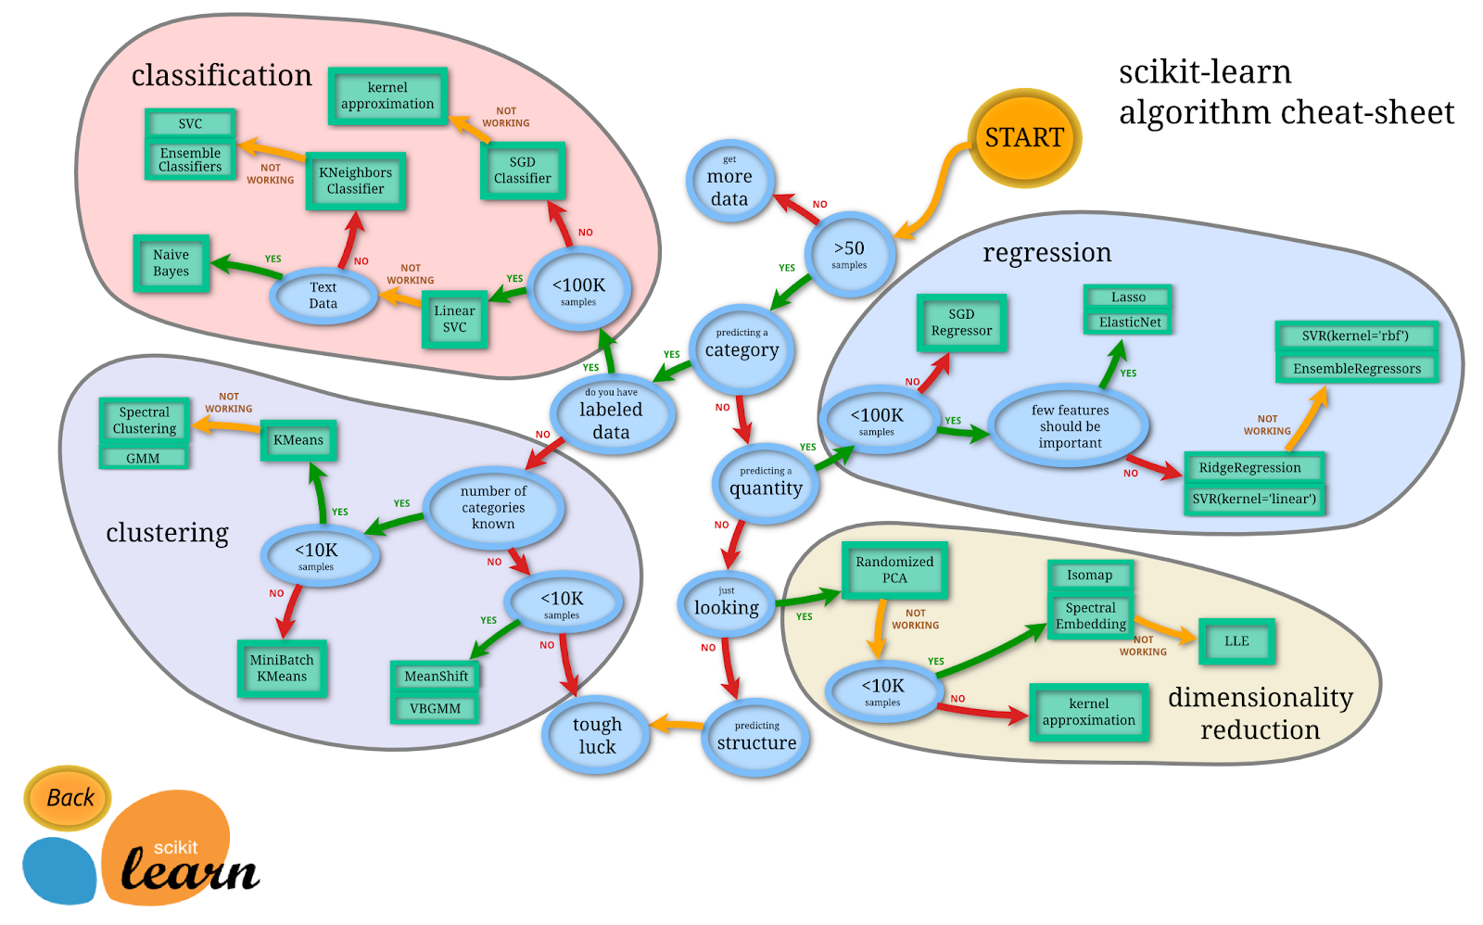
Machine Learning Algorithms

Slide 7
Machine Learning Applications
Segment customers based on their purchases so you can design a different marketing strategy for each segment
Suggesting a product that a customer might be interested in based on past purchases
Analyzing images of products on a production line to automatically classify
Automatically categorize the news
Automatically flag offensive comments on discussion forums
Create a chatbot or personal assistant
Predict your company's revenue for the next year based on many performance metrics
Making your app respond to voice commands
Creating a smart bot for a game

Slide 8
Mathematics in Machine Learning

Slide 9
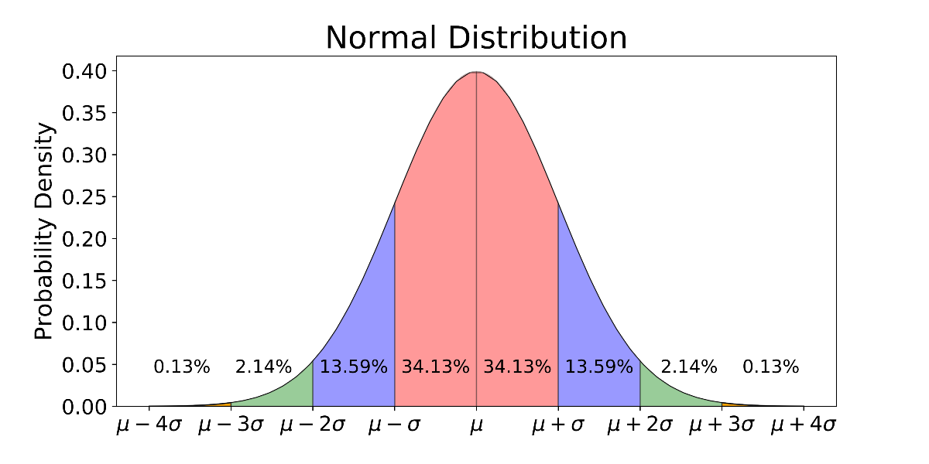
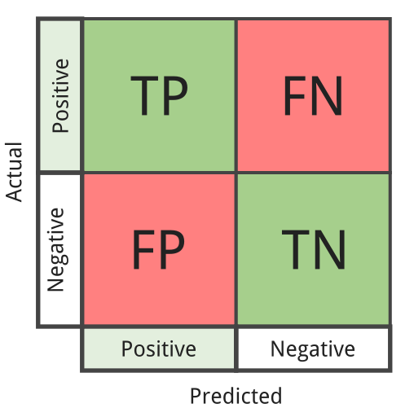
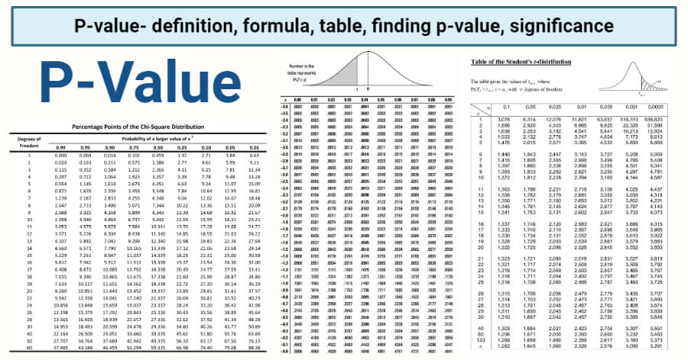
Probability and Statistics
Distributions
Model Performance Measurements
Descriptive Statistics and Statistics Tests

Slide 10
Model Training

Slide 11
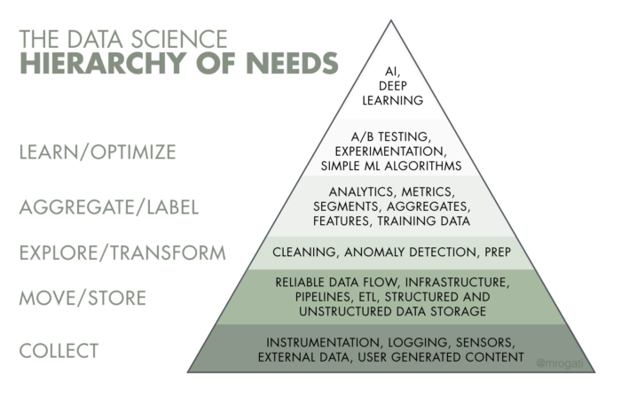
Machine Learning Project Steps
Seeing the big picture and understanding the project
Collect data
Examine and visualize data
Fitting Data to Machine Learning Models
Model selection and training of the model
Optimizing the model
Integrating the model into the system

Slide 12
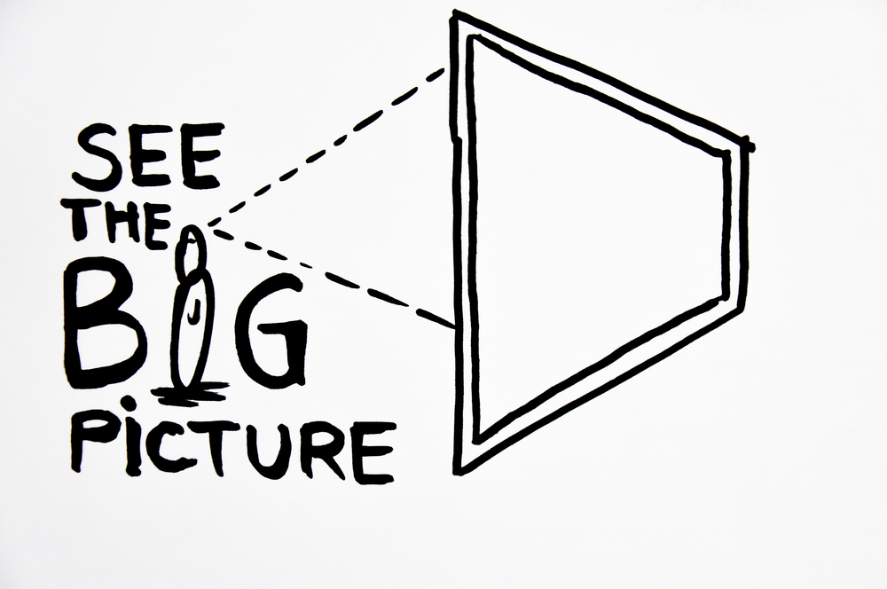
Big picture and understanding the project
Define the goal in terms of business
What are the current solutions/workarounds?
How should you evaluate this issue (supervised/unsupervised, online/offline etc.)?
How should performance be measured?
What would be the minimum performance required to meet the business goal?
Is human expertise available?
How do you fix the problem manually?
List the assumptions you (or others) have made so far

Slide 13
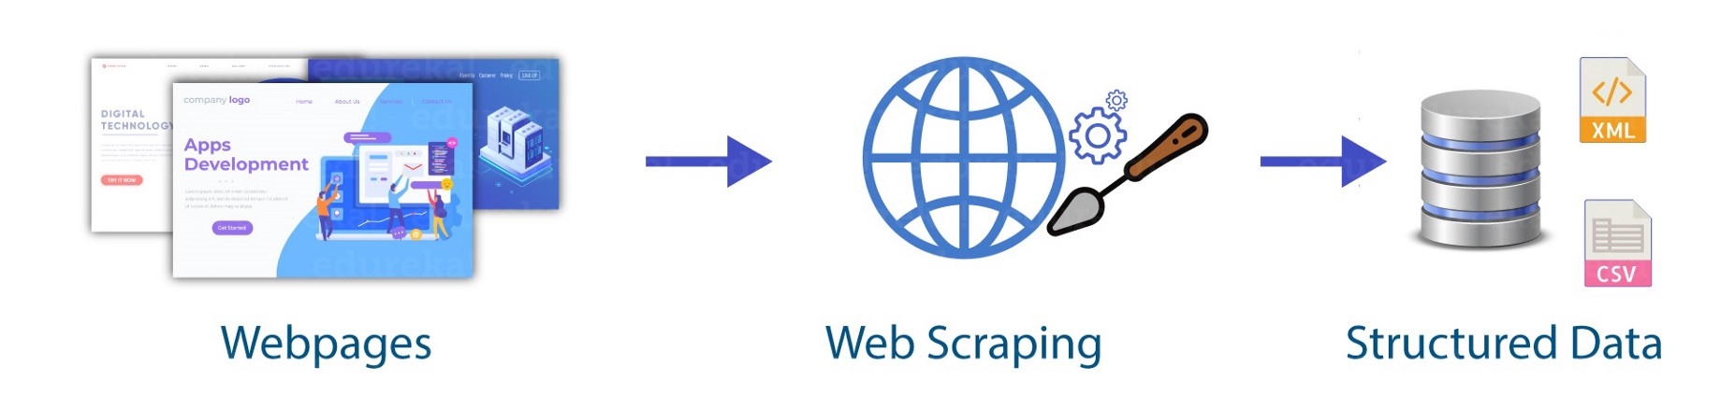
Collect Data
Prepare a Working Environment
Data should be stored neatly and appropriately in machine learning projects. In particular, the raw data should not be damaged and their structures should not be damaged. The data to be used and pre processed in the model should be stored and the data sent to the model should be stored. Therefore, appropriate databases should be established or folder hierarchies should be provided.
Get the Data
There are many sources that can obtain data, data sets obtained from the internet can be used during learning stages, working with real-world data sets is a bit more difficult, sometimes this data is not easy to obtain, but these data can be collected over the internet with software.

Slide 14
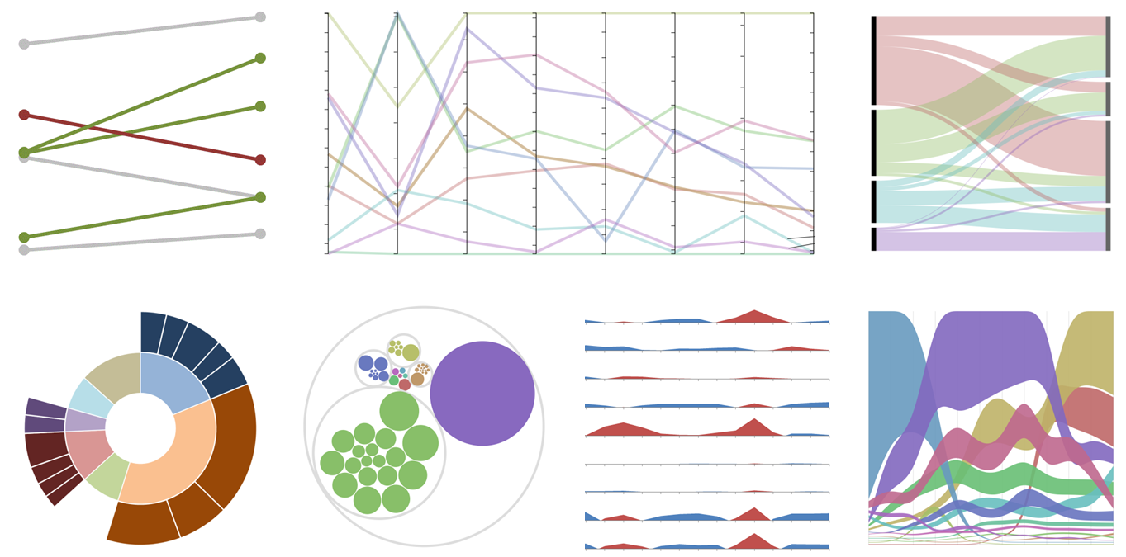
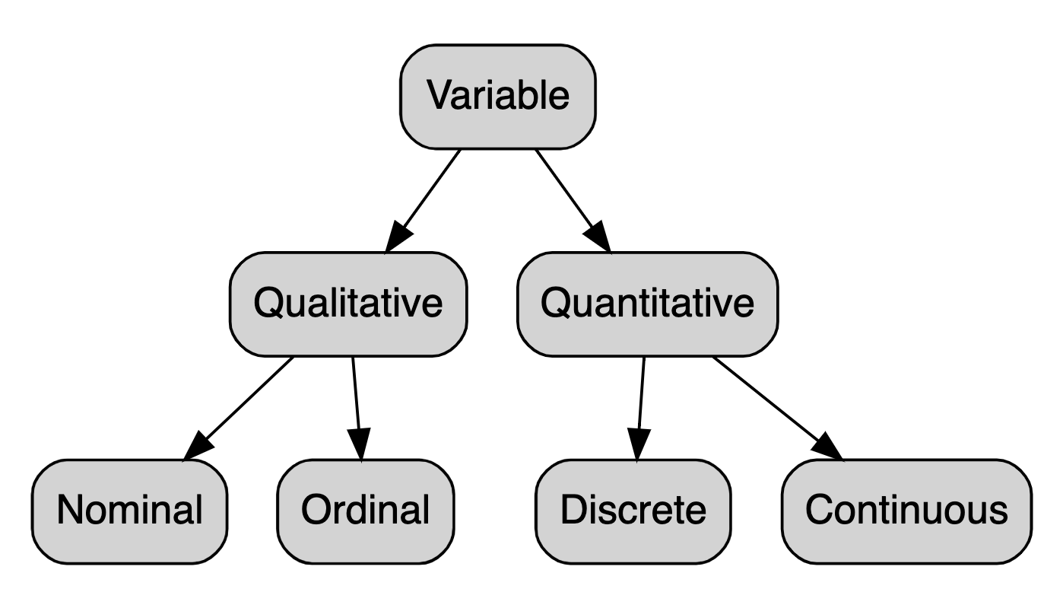
Examine and Visualize Data
Exploratory Data Analysis (EDA)
It is the work that allows us to quickly recognize the data, given to creating simple graphs (eg box charts, scatter plots) that help to draw a picture of a data set, along with summary statistics (mean, median, quantities, etc.).

Slide 15
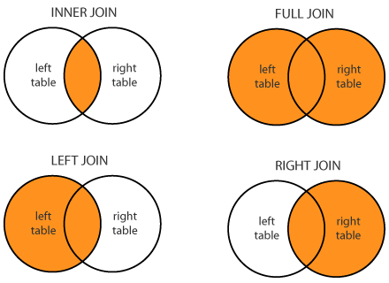
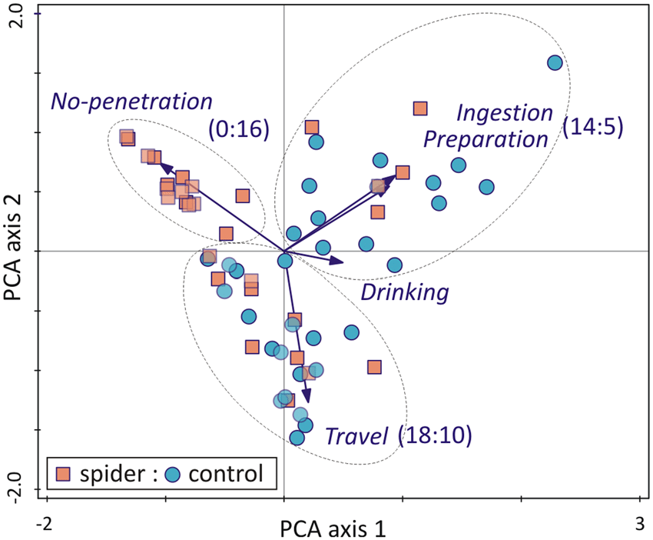
Fitting the Data to the Model
Cleaning and Editing Data
Cleaning up Unnecessary or Non-Informational Data
Fixing wrong data
Combining data from different sources
Determining Data Types
Date, Numeric, Text etc. checking data in formats
Performing appropriate data type conversions
Data Size Reduction
PCA
Elimination of redundant columns and correlation analysis
Examination of data distributions and regularization
Min-max Scaling
Standardization

Slide 16
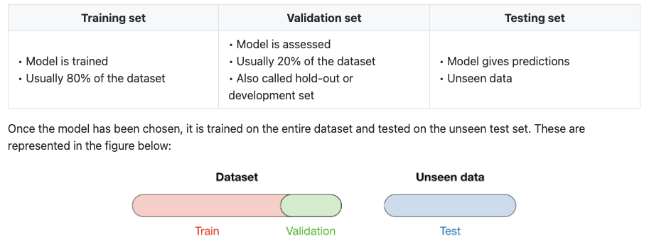
Model selection and training of the model

Slide 17
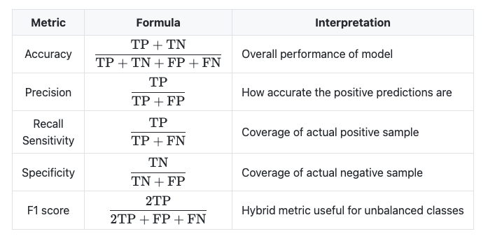
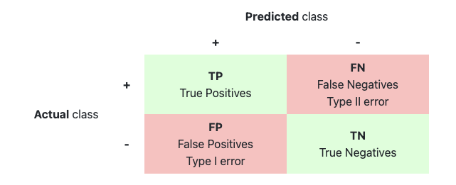
Success Performances: Classification Metrics
Complexity Matrix

Slide 18
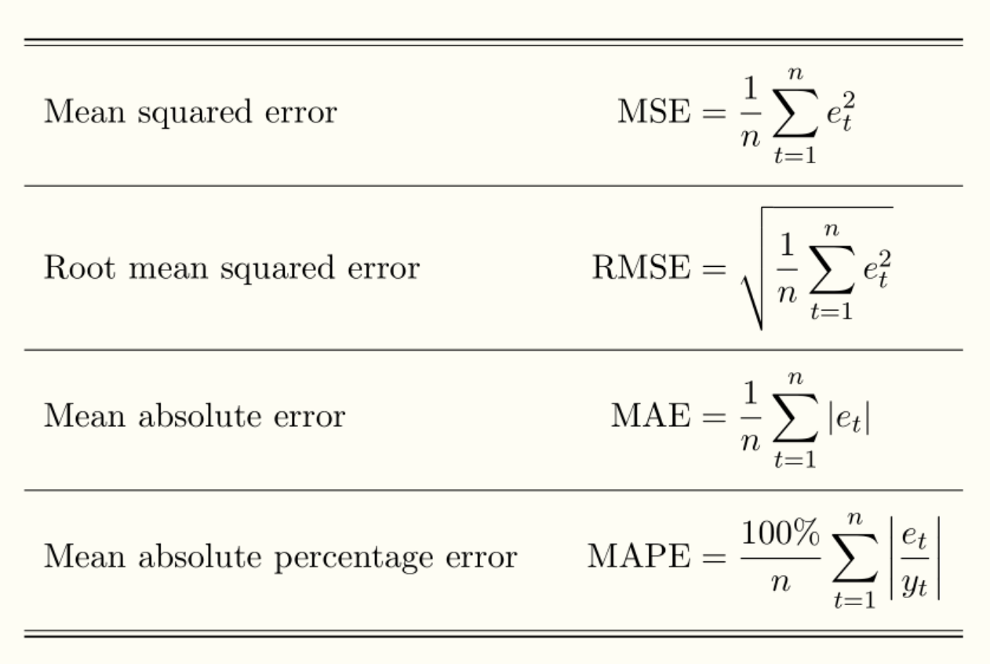
Success Performances: Regression Metrics

Slide 19
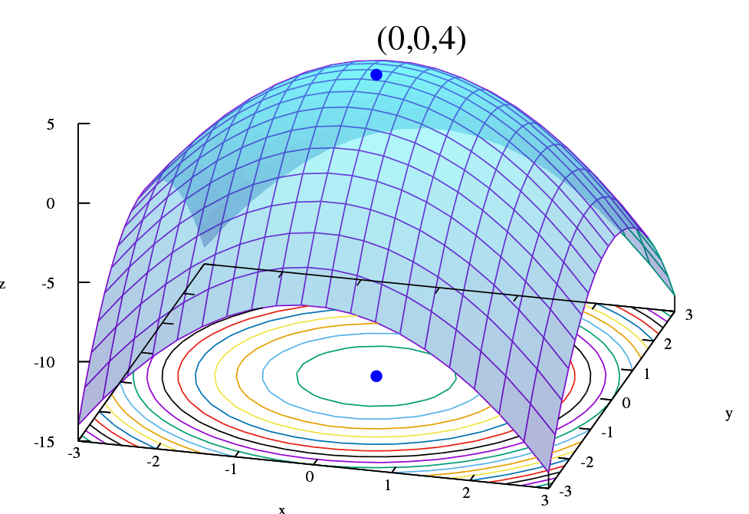
Optimizing the model
Fine tune hyperparameters using cross validation
Perform hyperparameter searches, gridsearch etc.
Try Ensemble methods. Combining your best models often performs better than running them individually
You'll want to use as much data as possible for this step, especially as you move towards the end of the tweak.
Once you are sure of your final model, measure its performance on the test set to estimate its generalization error.

Slide 20
Machine Learning Terminologies

Slide 21
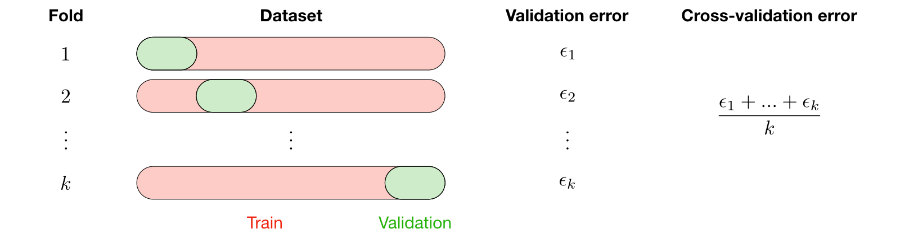
Cross Validation
Cross validation, also called CV, is a method used to select a model that does not rely heavily on the initial training set.

Slide 22
Bias - Variance Tradeoff
Bias: The bias of a model is the difference between the expected prediction and the correct model we are trying to predict for the given data points.
Varyans: The variance of a model is the variability of the model estimate for given data points.
Deviation/variance Tradeoff: The simpler the model, the higher the bias, and the more complex the model, the higher the variance.
 | Underfitting | Ideal | Overfitting
Symptoms | Higher training error Training error close to test error High bias | Training error slightly lower than test error | Very low training error Training error is considerably lower than test error High variance

Slide 23
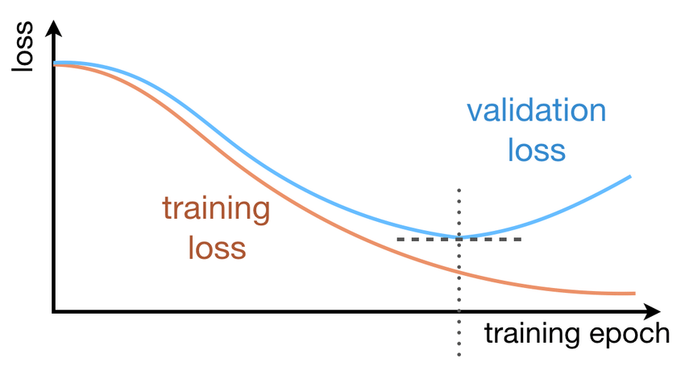
Early Stopping

Slide 24
Tools Used in Machine Learning

Slide 25

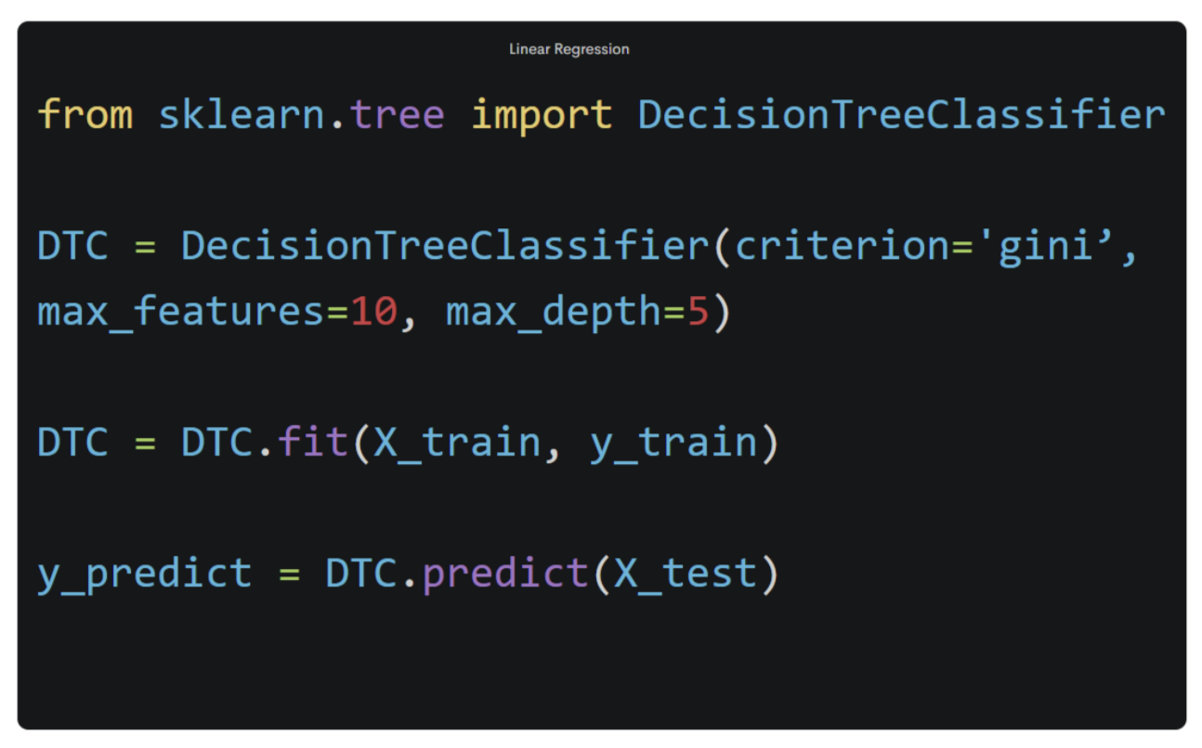
Tools Used in Machine Learning
Python is a general purpose programming language.
As an interpreted and dynamic language, Python mainly supports object-oriented programming approaches and functional programming.
Rapid prototyping
Basic Syntax
Easy to use
Large Community

Slide 26
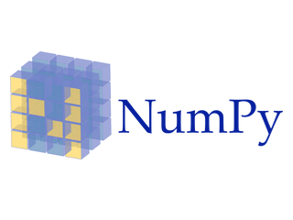
Tools Used in Machine Learning
NumPy is the basic package used for scientific calculations in Python.
Creating an array
Vectorization and slicing
Matrices and simple linear algebra
Data files

Slide 27

Tools Used in Machine Learning
Pandas is an open source Python library that facilitates data analysis and data preprocessing.
Useful functions for data manipulation
Tools to read and write data between different formats: CSV and text files, Microsoft Excel, SQL databases
Fast data visualization at a simple level

Slide 28
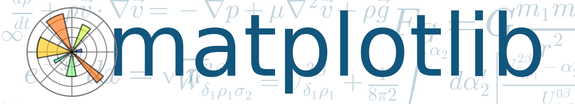
Tools Used in Machine Learning
Matplotlib is a data visualization and plotting library for the Python programming language
The matplotlib plotting package is one of the most important tools for scientific programming with Python
Matplotlib is a very powerful library. Can visualize data interactively
We can produce high quality outputs suitable for printing and publication.
Both two-dimensional and three-dimensional graphics can be produced

Slide 29
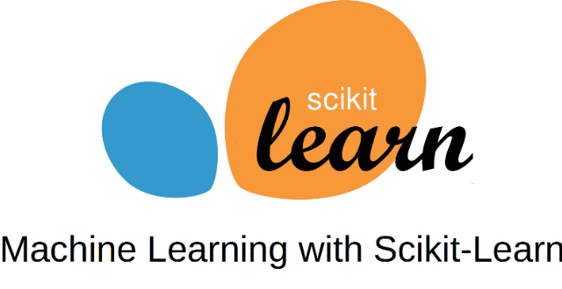
Tools Used in Machine Learning
Scikit-learn is a free software machine learning library for the Python programming language.
It includes many basic methods such as linear regression, logistic regression, decision trees, random forest.
https://scikit-learn.org/stable/

Slide 30
Datasets

Slide 31

Kaggle
Kaggle is an online community for data scientists and machine learning practitioners.
It is a platform where owners of large or small problems express their data and problems in order to solve the relevant problem, and the participants participate in competitions to solve the problem within the information given.
Hundreds of datasets
Prize competitions
Education and guides

Slide 32

UCI
UCI is the dataset repository provided by the machine learning and intelligent systems research center at the University of California, Irvine.
It currently hosts 588 datasets as a service to the machine learning community.
https://archive.ics.uci.edu/ml/index.php

